Slide 1
Welcome to Kindergarten Night!

Slide 2
Our goal for tonight is to help you get familiar with our school and Full Day Learning Program. We want to help your child adjust quickly to the school setting, enjoy learning, and develop a positive attitude towards education! Let’s get started!

Slide 3
Be sure to subscribe to our classroom website and/or Twitter account. Please see your child’s teacher for the exact address

Slide 4
The Kindergarten Team
Our team is made up of an English Teacher, a French Teacher and an Early Childhood Educator (ECE). In our classroom you will see that the kindergarten team:
Has set up a safe and welcoming classroom with many materials that promote play-based learning
Encourages children to learn through play, independent problem solving and inquiry.
Documents and assesses student learning
Helps students learn to problem solve and self regulate

Slide 5
Why The Inquiry Based Model?
* Children are naturally curious and have an interest in exploring and investigating to see how things work and why they happen. The Full Day Early Learning Kindergarten program capitalizes on children's natural desire for inquiry. Through play, children develop the ability to self-regulate, communicate, negotiate, investigate and problem solve.
A Kindergartener’s Job Is To Learn
Through Play!

Slide 6
Why The Inquiry Based Model?
* With the support of the Full Day Kindergarten team, the children's natural curiosities can be expanded and extended into powerful inquiries that can take place around the various centres in the kindergarten classroom. When the children take a role in the planning and implementation of these authentic and meaningful inquiries, powerful learning occurs.
A Kindergartener’s Job Is To Learn
Through Play!

Slide 7
What Will A Typical Day In Kindergarten Look Like?
Morning Routine
Short lesson focus (read a story, big book, Phonemic Awareness activities, word work, Smartboard activities, interactive Read Aloud, writing task, counting songs, number recognition…)
Inquiry based learning centers/ working collaboratively with classmates
Snack time
Music and Movement activities
Lunch/Quiet time
Outdoor Play (40 minutes)

Slide 8
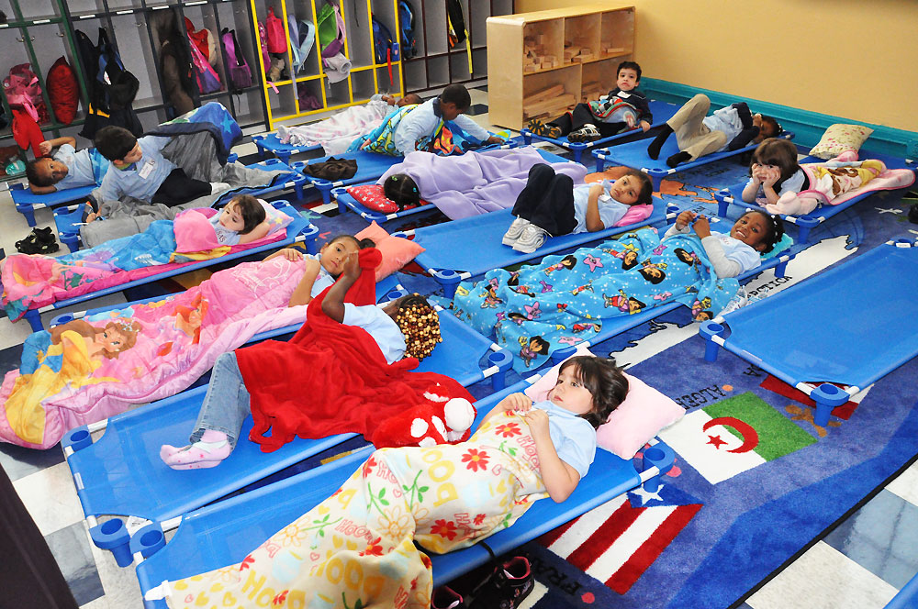
Quiet Time
A 40 minute quiet time that is mandated by the Ministry of Education. It is an important time for children to rest their bodies and consolidate their learning from the morning activities.
Research shows that similar to adults, children also need rest time throughout the day. They do not have to sleep!
It is a time to also learn important Self Regulation
skills.
Quiet and soothing music is played

Slide 9
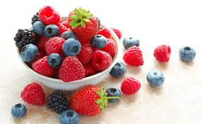
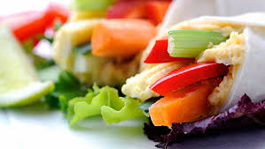
Snacks and Lunches
Students have a morning snack, lunch and then an afternoon snack. If you have signed up for hot lunches, please send in snacks for the day.
Some healthy nut free/fish and seafood free snack ideas are: fruit, crackers and cheese, vegetables and dip, yogurt, fruit bar etc.
In order to protect our students with allergies, please do not send in any treats for the class.

Slide 10
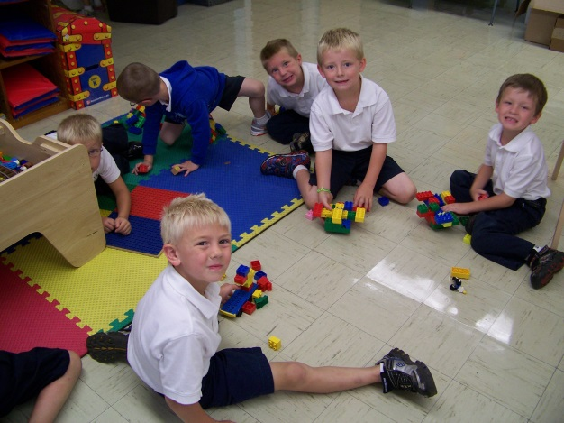
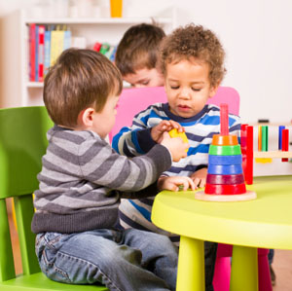
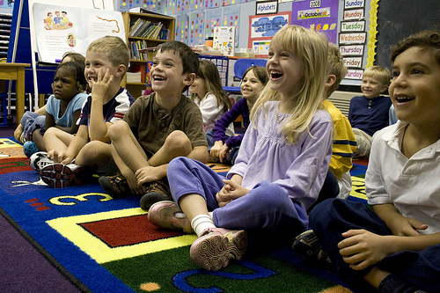
Personal and Social Development
Children will learn how to….
Self regulate
Give compliments and accept different points of view.
Wait their turn, share, and listen to what others have to say.
Recognize when friends are upset and show empathy.
Problem-solve to help themselves and others.
Play and work with other children.
Understand that there are consequences to actions.
Talk about their heritage or cultural background.
Know their likes and dislikes, express their thoughts, and recognize their own accomplishments.

Slide 11
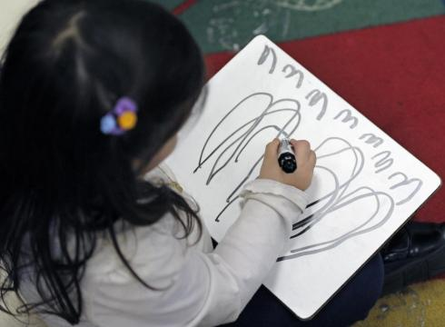
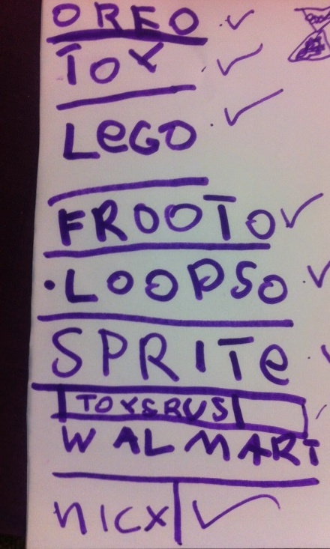
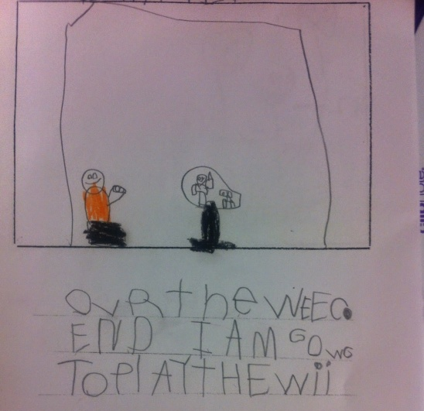
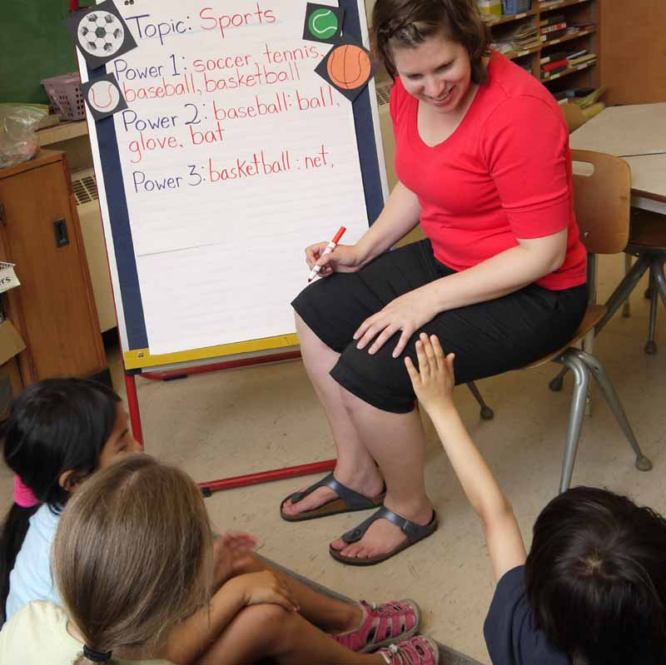
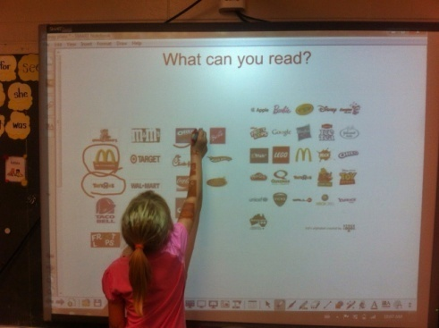
Language Arts
Writing
Oral Communication
Modeled/
Shared Writing
Reading

Slide 12
Language Arts
Oral Language:
Oral language is the foundation of literacy development. Children have many opportunities throughout the day to actively listen to others and to share their ideas, experiences, opinions and questions during whole group, and small group activities. The Full Day Kindergarten team helps guide oral language development by listening attentively to children's responses and interactions, providing richer responses to guide children's thinking and introducing new vocabulary.

Slide 13
Language Arts
Within the Kindergarten programme opportunities are presented throughout the day for the children to be involved in a variety of Reading and Writing activities. The level of support given by the teachers and the size of the groups involved is dependent upon the activity.

Slide 14
Language Arts
Reading
Modelled/Read Aloud (whole group)
Shared Reading (whole group)
Guided Reading (small group)
Independent Reading (on their own)
Writing
Modelled Writing
Shared Writing
Guided Writing
Independent Writing

Slide 15
Language Arts
Media Literacy
This involves reading, writing and interpreting signs and posters and messages in movies, commercials, pamphlets etc.

Slide 16
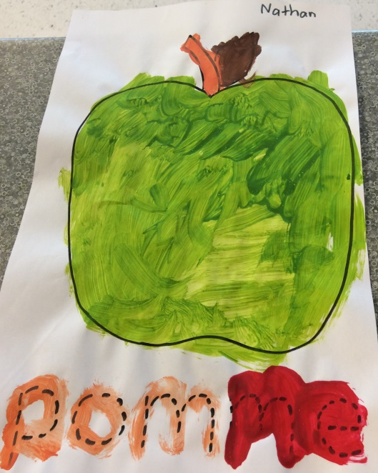
French
Through exposure to French language every other day by means of explicit instruction, songs, stories and conversations, the students will learn to communicate and interact with growing confidence in French language.

Slide 17
French
The French program in Full-Day Kindergarten runs parallel to the English program, with a focus on listening and speaking, comprehension and reading.

Slide 18
French
Students will learn to make predictions and respond to a variety of French materials read aloud to them, and will begin to experiment with a variety of simple writing forms using a combination of pictures, symbols, familiar words and classroom resources.

Slide 19
French
Specific vocabulary words will no longer be taught in pre-planned units, but will be brought about and learned based on the needs and interests of the children. Children will learn vocabulary that is pertinent to them and necessary for them to communicate their needs and wishes throughout their school day.

Slide 20
Mathematics
We will learn about…
Numbers, counting and that quantities can get bigger or smaller.
Measurement: comparing length, weight, temperature and size of different objects.
Two and three dimensional shapes
Spatial sense
Patterning and sorting
Canadian coins

Slide 21
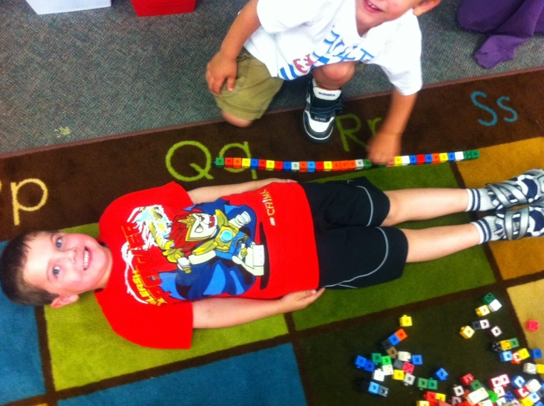
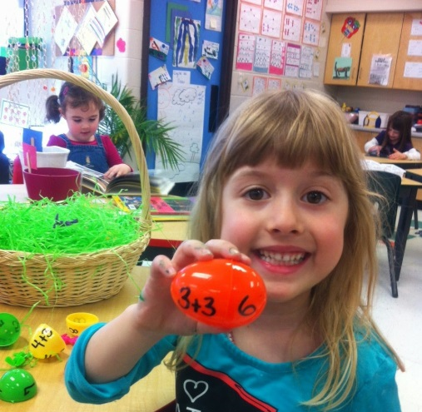
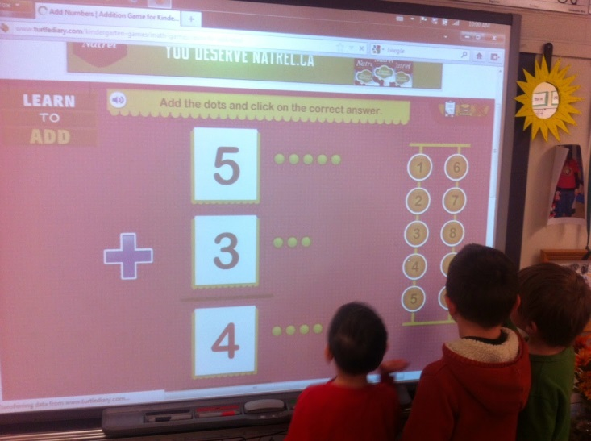
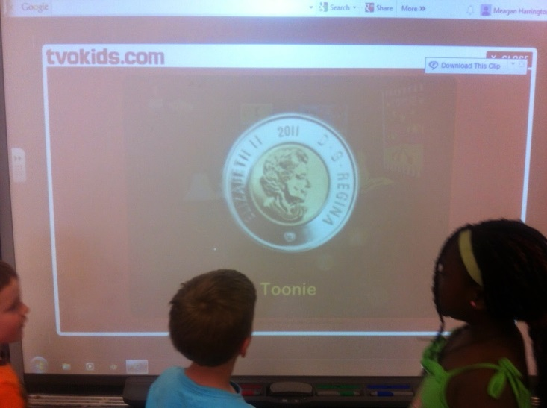
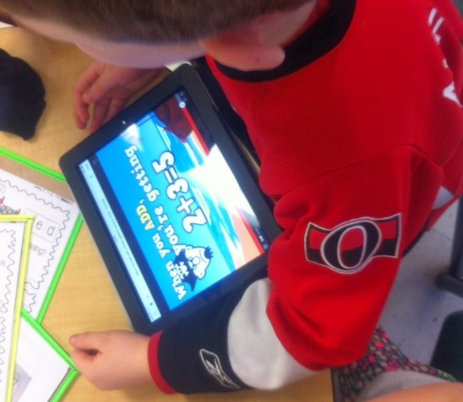
Math In Action!
Measuring ourselves using non standard units
Mass and Capacity
Easter Egg Addition
Learning about Canadian Coins
Smartboard Addition
Learning math
on the Ipad

Slide 22
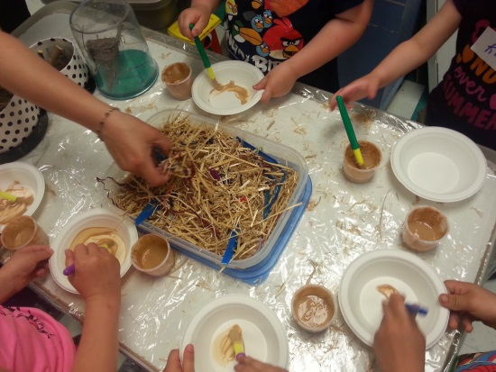
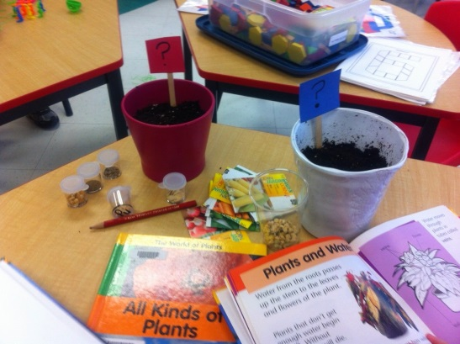
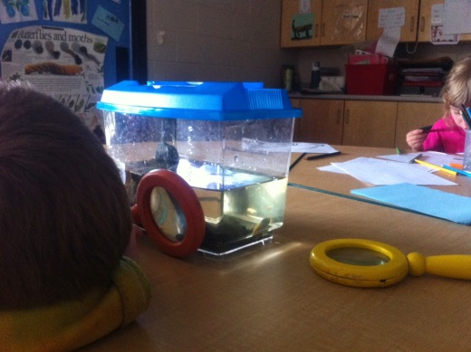
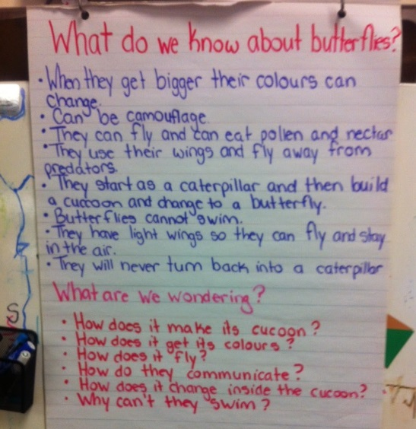
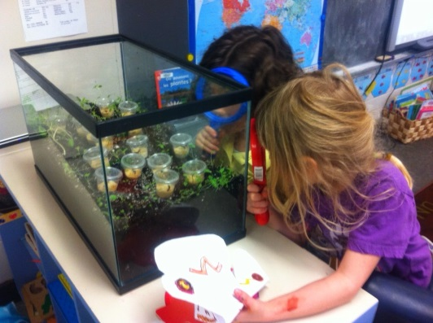
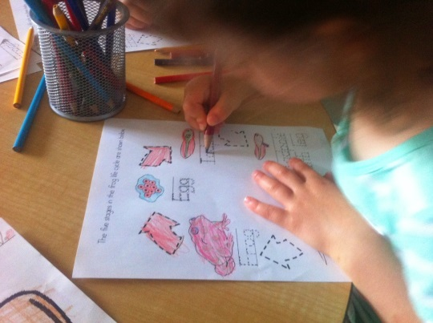
Children Are Naturally Curious About Their Environment
What will the mystery seeds be?
Creating birds nests
Tadpoles in the classroom
Butterfly Inquiry
Caterpillars turning into butterflies
Learning the Life Cycle Of A Frog
Hands on Science Learning Is Fun!

Slide 23
Important Reminders….
If you write us a note, please leave the page opened to it. Closed books will not be looked at.
Please label all Tupperware, water bottles and lids
Label EVERYTHING
Please ensure your child has shoes they can put on independently, they also need to be safe to use in the gym

Slide 24
Need To Get In Touch With Us?
Your child’s Communication Book will be the primary source of communication. Please leave the book open to any notes.
Be sure to look at our classroom website and/or Twitter accounts to stay up to date with what we are learning in the classroom.

Slide 25
On The Other Side of the Door
On the other side of the door I can be a different me, As smart and as brave, as funny or strong As a person could want to be. There's nothing too hard for me to do, There's no place I can't explore Because everything can happen On the other side of the door. On the other side of the door I don't have to go alone. If you come, too, we can sail tall ships And fly where the wind has flown. And wherever we go, it is almost sure We'll find what we are looking for Because everything can happen On the other side of the door. -Jeff Moss

Slide 26
Thank you for coming! We look forward to working with you this year!

